Slide 1
Friday, January 20, 2017
Write In Your Agenda:
Write In Your Monitoring Log:
CW:
Food Chains and Food Webs Power Point and Note sheet
HW:
Finish classwork
Have Monitoring Log signed.
Response to Warm-Up:
Describe your experience completing the food chains in yesterday’s activity.
You will need:
Pencil
Monitoring Log

Slide 2
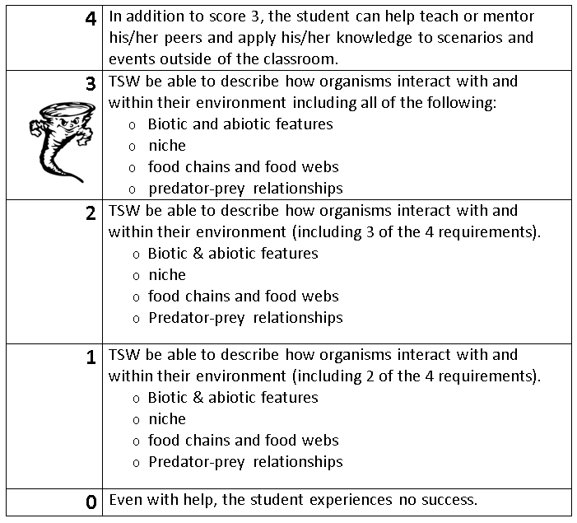
Learning Goal and Scale
TSW be able to describe how organisms interact with and within their environment (including biotic and abiotic features, niche, food chains & webs, and predator-prey relationships).

